Slide 1
Integrating SAP & MES
Sham Afzalpurkar
CEO
Performix Inc

Slide 2

Agenda
Introduction
MES and Shop Floor Automation Systems (SFA) Overview
Positioning MES SFA along with ERP
Integrating SAP and MES
Case Study
Open Q & A

Slide 3
Introduction
Sham Afzalpurkar, CEO Performix Inc
About Performix
  A Manufacturing Execution Systems company
  Significant Supply Chain, Manufacturing Execution &Track/Trace experience
  Focus on Pharmaceuticals and Process Industries
  Offices in Houston, Texas with development teams in India

Slide 4
Agenda
Introduction
MES and Shop Floor Automation Systems (SFA) Overview
Positioning MES SFA with along with ERP
Integrating MES with SAP
Case Study
Open Q & A

Slide 5
Why Manufacturing Execution Systems?
In the last decade, ERP and SCM have NOT delivered the expected returns
Focus on deploying MES solution to give visibility and flexibility and effectively manage supply chain
Competition has forced quality products at lower cost
Integration of ERP and MES has been a challenge
Standards such ISA 95 have simplified the deployment

Slide 6
What is Manufacturing Execution System?
Co-ordinate functions on the shop floor to optimize the plant activities
  Equipment WF (set up run)
  Material Handling WF
Manufacturing Execution System provides effective integration between production processes and enterprise business systems.
Layer of communication between business and control systems
ERP
MES
SHOP FOOR AUTOMATION

Slide 7
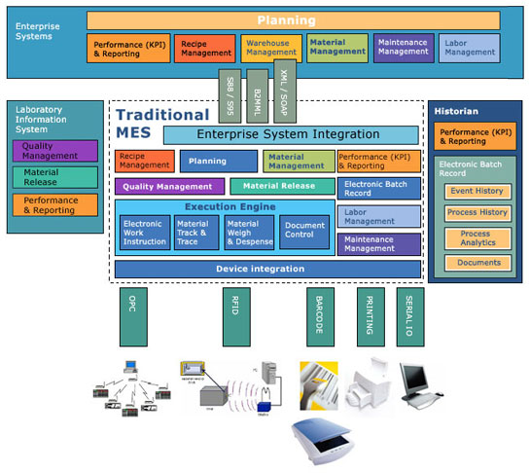
Manufacturing Execution System

Slide 8
Components of MES
Core
  Material and Production Tracking
  Material Handling and Production Procedures
  Resource management and allocation
  Production Dispatching
  Data Collection
Extensions
  Compliance
  Quality Assurance
  Performance Analysis
  Scheduling
  Document Management
  Labor Management

Slide 9
What is ISA 95?
Instrumentation, Systems, and Automation Society (ISA) Standard
Standard that defines how to link Enterprise and Controls systems using a Manufacturing Execution Systems (MES) layer.
This standard describes:
  The MES Functionality
  The Data base schema at the MES Level
  The Messages between the Enterprise system and MES

Slide 10
How does ISA 95 help ?
Provides definition of the functions associated with the interface between control functions and enterprise functions
Provide a definition of the information that is shared between control functions and enterprise functions
Facilitates enabling of real time access of data across manufacturing operations

Slide 11
ISA 95 - Domain Definitions
Level 4
Business Planning
& Logistics
Plant Production Scheduling,
Operational Management, etc
4 - Establishing the basic plant schedule - production, material use, delivery, and shipping. Determining inventory levels.
Time Frame
Months, weeks, days, shifts
Level 3
Manufacturing
Operations Management
Dispatching Production, Detailed Production
Scheduling, Reliability Assurance, ...
3 - Work flow / recipe control, stepping the process through states to produce the desired end products. Maintaining records and optimizing the production process.
Time Frame
Shifts, hours, minutes, seconds
Level 2
Batch
Control
Continuous
Control
Discrete
Control
2 - Monitoring, supervisory control and automated control of the production process
Level 1
1 - Sensing the production process, manipulating the production process
Level 0

Slide 12
ISA 95 – With Applications
Level 4
Business Planning
& Logistics
Plant Production Scheduling,
Operational Management, etc
4 - Establishing the basic plant schedule - production, material use, delivery, and shipping. Determining inventory levels.
Time Frame
Months, weeks, days, shifts
ERP
Level 3
Manufacturing
Operations Management
Dispatching Production, Detailed Production
Scheduling, Reliability Assurance, ...
3 - Work flow / recipe control, stepping the process through states to produce the desired end products. Maintaining records and optimizing the production process.
Time Frame
Shifts, hours, minutes, seconds
MES
Level 2
Batch
Control
Continuous
Control
Discrete
Control
2 - Monitoring, supervisory control and automated control of the production process
SFAC
SCADA/PLC/DCS
Level 1
1 - Sensing the production process, manipulating the production process
Level 0

Slide 13
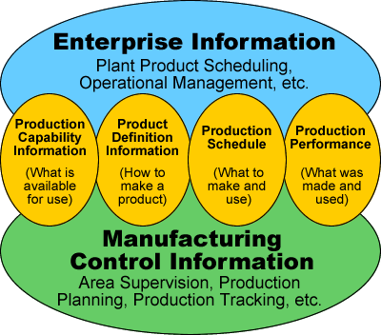
Information Exchange Between Level 3 & 4

Slide 14
What is B2MML?
The World Batch Forum (WBF) has published XML schemas based on the S95 Model - B2MML (Business to Manufacturing Markup “Hypertext” Language)
B2MML-V0201-Common.xls
B2MML-V0201-Personnel.xls
B2MML-V0201-Equipment.xls
B2MML-V0201-Material.xls
B2MML-V0201-Maintenance.xls
B2MML-V0201-ProcessSegment.xls
B2MML-V0201-ProductionDefinition.xls
B2MML-V0201-ProductionCapability.xls
B2MML-V0201-ProducitonPerformance.xls
B2MML-V0201-ProductionSchedule.xls

Slide 15
Agenda
Introduction
MES and Shop Floor Automation Systems (SFA) Overview
Positioning MES SFA along with SAP
Integrating MES with SAP
Case Study
Open Q & A

Slide 16
Business Functions (S95)
Enterprise Performance Reporting
Level 4
Business
Planning &
Logistics
Demand
Planning
Supply Chain Planning
Cost Accounting
Human Resource
Management
Sales &
Distribution
Material
Management
Production
Planning
Warehouse
Management
Maintenance
Management
Detail Scheduling
Process
Optimization
Recipe
Management
Performance
Management
Process
Analysis
Level 3
Manufacturing
Operations
Resource
Management
Production
Execution
WIP Material
Management
Production
History
Quality
Management
Real-Time
Execution
Real-Time
SPC
Level 2
Plant Floor
Control
Real-Time
Control
Real-Time
Monitoring

Slide 17

Simple Discrete
ERP
Enterprise Performance Reporting
Demand
Planning
Supply Chain Planning
Cost Accounting
Human Resource
Management
Sales &
Distribution
Material
Management
Production
Planning
Warehouse
Management
Maintenance
Management
Detail Scheduling
Performance
Management
Process
Analysis
Resource
Management
Production
Execution
WIP Material
Management
Production
History
Quality
Management
Some PLCs
Machines & Work Centers
Fixed Routes, No Lot Splitting
Only Ingredients Changes
Real-Time
Execution
Real-Time
SPC
Real-Time
Control
Real-Time
Monitoring

Slide 18
Complex Discrete
Aerospace and Automotive
ERP
Enterprise Performance Reporting
Demand
Planning
Supply Chain Planning
Cost Accounting
Human Resource
Management
Sales &
Distribution
Material
Management
Production
Planning
Warehouse
Management
Maintenance
Management
Detail Scheduling
Process
Analysis
MES Thousands of parts, complex procedures, many products
Resource
Management
Production
Execution
WIP Material
Management
Production
History
Quality
Management
Some PLCs
Machines & Work Centers
Production Lines
Real-Time
Execution
Real-Time
SPC
Real-Time
Control
Real-Time
Monitoring

Slide 19
Semiconductor
ERP
Enterprise Performance Reporting
Demand
Planning
Supply Chain Planning
Cost Accounting
Human Resource
Management
Sales &
Distribution
Material
Management
Production
Planning
Warehouse
Management
Maintenance
Management
many shared resources, complex routing, many products
MES thousands of parts, complex procedures
Detail Scheduling
Process
Optimization
Recipe
Management
Performance
Management
Process
Analysis
Resource
Management
Production
Execution
WIP Material
Management
Production
History
Quality
Management
Some PLCs
Machines & Work Centers
Production Lines
Real-Time
Execution
Real-Time
SPC
Real-Time
Control
Real-Time
Monitoring

Slide 20
Pharmaceuticals & Specialty Chemicals
ERP
Enterprise Performance Reporting
Demand
Planning
Supply Chain Planning
Cost Accounting
Human Resource
Management
Sales &
Distribution
Material
Management
Production
Planning
Warehouse
Management
Maintenance
Management
many shared resources, large recipes, many products
MES compliance, complex procedures
Detail Scheduling
Process
Optimization
Recipe
Management
Performance
Management
Process
Analysis
Resource
Management
Production
Execution
WIP Material
Management
Production
History
Quality
Management
SCADA / PCS
Equipment Trains
Flexible Connections
Real-Time
Execution
Real-Time
SPC
Real-Time
Control
Real-Time
Monitoring

Slide 21
Oil & Gas and Bulk Chemicals
ERP
Enterprise Performance Reporting
Demand
Planning
Supply Chain Planning
Cost Accounting
Human Resource
Management
Sales &
Distribution
Material
Management
Production
Planning
Warehouse
Management
Maintenance
Management
SCADA / PCS
Equipment Trains
Fixed Connections
Large number of control variables, real-time optimization
Process
Optimization
Performance
Management
Process
Analysis
Production
History
Quality
Management
Real-Time
Execution
Real-Time
SPC
Real-Time
Control
Real-Time
Monitoring

Slide 22
Agenda
Introduction
MES and Shop Floor Automation Systems (SFA) Overview
Positioning MES SFA with along with ERP
Integrating MES with SAP
Case Study
Open Q & A

Slide 23
MES Integration with SAP - Options
SAP and MES Integration Using xMII
SAP and MES Integration - Custom

Slide 24

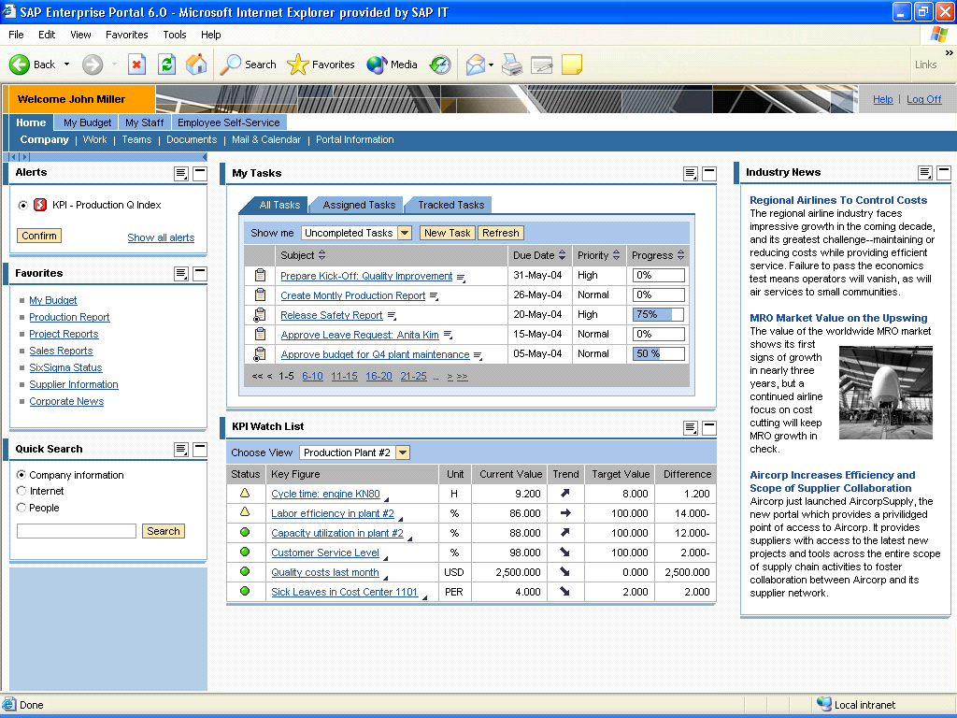
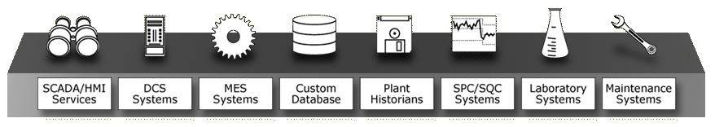
SAP MES Integration Using xMII
Enterprise
  SAP xMII enables real-time transactional integration between plant floor and enterprise (SAP ERP) systems out-of-the box thru:
  Universal Connectivity to the data, functionality and processes of existing plant floor systems and SAP
  Advanced composite application capabilities for creating automated events, KPIs and alerts, and new manufacturing business processes
  Synchronization of SAP ERP with real-time Plant Floor Systems and Processes using proprietary and standards-compliant messages and workflows
  Data Services that provide a foundation for Manufacturing Synchronization and Intelligence
SAP NETWEAVER
SAP Manufacturing
(mySAP ERP)
Manufacturing Intelligence Dashboards
Other SAP Bus. Solu tions
SAP BI
XI
SAP xMII
Manufacturing Intelligence
Manufacturing Integration
Plant Floor

Slide 25
MANUFACTURING INTELLIGENCE
Visualization Services
  Charts, grids, tickers, UI controls
  Dashboard components
Analytic Services
  SPC/SQC (Six Sigma) analyses
  Statistical and other mathematical analyses
MANUFACTURING INTEGRATION
Data Services
  Bi-directional data access
  Metadata browsing
  XML-based data abstraction
  Connectors to external systems
Business Logic Services
  Logic
  Integration services
  Notification services
  Calculation and data transformation
  Content creation
SAP xMII
Mfg. Intelligence
Mfg. Integration
Manufacturing Intelligence
Manufacturing Integration
Web Services
All services exposed as web services
Includes user-defined composite services
Business Logic
Services
S95/B2MML Standard
Visualization
Core Mfg Services
Other Standards
KPI
Web Services
Alerts
Analytics
Data Services
Connectors
Notes:
xMII is a complete, self-contained application with no dependencies on SAP ERP or SAP NetWeaver for its implementation
Of course, it is deeply and automatically integrated with SAP technologies when they are present
xMII 2006 will embed SAP web application server, but there will be no other component dependencies
xMII was designed using an SOA from its inception and integrates seamlessly into the SAP ESA model

Slide 26
SAP xMII Architecture – Overview
SAP xMII Business Package for XI
Core manufacturing services and standards-based mappings in XI
Part of xMII software component
Service enablement/simplification for ERP 4.X
SAP ERP
QM
MM
PP/PI
PM
APO
CRM
…
SAP NetWeaver
XI
SAP xMII Core Manufacturing
Services
BW
EP
Enterprise Service Repository
BAPI/RFC/IDOC Repository
Industry Standard Business Packages (e.g. S95)
SAP xMII
Visualization
Services
Analytical
Services
Logic
Services
Data Services
SAP xMII Core Services
Plant floor data connectivity
Rich visualization capabilities
Business logic/mappings
Six Sigma Analytics
Events, alerts and KPIs
Orders, Specifications,
Master Data
Costing/Usage, Quality,
Production, Maintenance Data
Notes:
This shows the “logical architecture” of xMII including the core manufacturing services and the S95 business package, which are part of xMII
The “core manufacturing services” deliver a higher level interface to SAP ERP for manufacturing integration, and provide a path for customers from ERP 4.X to ESA-enabled versions of SAP ERP
These core manufacturing services provide the foundation for standards-based integration and direct integration
The core services are under development, and are the result of collaboration between SAP and key shop floor partners and customers

Slide 27
SAP xMII synchronizes manufacturing operations
SAP xMII extracts data from SAP ERP and provides real-time visibility and distribution to Plant Floor Systems of:
Enterprise
SAP xMII’s ability to perform transaction execution into SAP also enables automated, plant-level creation of:
SAP NETWEAVER
SAP Manufacturing
(mySAP ERP)
Manufacturing Intelligence Dashboards
Other SAP Bus. Solu tions
SAP BI
Production Confirmations
Process Messages
Material Receipts
Material Consumptions
Material transfers
Inspection results recording
Quality Notifications
Batch Characteristic recording
Work Orders & results recording
Maintenance Notifications
Planned Orders
Bills of Material
Production & Process Orders
Material Inventory Levels
Inspection Lots Data
Master Recipes
Material Details
Batch Details
Resources & Functional Locations
Maintenance Work Order & Notification details
Material & Order Costs
XI
SAP xMII
Manufacturing Intelligence
Manufacturing Integration
Manufacturing Integration

Slide 28
MES Integration with SAP – Using xMII
SAP R/3, SCM, BW…
PEOPLE
SAP Enterprise Portal
Shopfloor Application – ANSI/ISA-95 Compliance
INFORMATION
SAP xMII
Integration
B2MML Msg
Use xMII Integration capabilities if S95 Non Compliant
= SAP
= 3rd Party Application
Notes:
Here we are showing the Architecture of shopfloor top floor integration using NetWeaver XI. Here the message exchange is in the form of B2MML Schemas, which is the implementation of ANSI/ISA-95 model.
If the shopfloor application is S95 compliance then the integration with SAP can be directly achieved with Netweaver XI.
If shopfloor application is not directly S95 Compliance but with the use of other connectors, it’s S95 compliance, then the integration can also be achieved.

Slide 29
MES Integration with SAP
Custom using Business Connector
SAP R/3, SCM, BW…
PEOPLE
SAP Enterprise Portal
Shopfloor Application – ANSI/ISA-95 Compliance with 3rd Party Connector
INFORMATION
SAP xMII
Business Connector
B2MML Msg
Integration
= SAP
= 3rd Party Application

Slide 30
Production Schedule Data Flow from SAP to Shop Floor Application
Step 1: Create the process Order
Step 2: Release the process Order
Step 3: Generate the control recipe
Step 4: Send the control recipe from control recipe monitor
- Invoke XI
- Based on the data passed from SAP-System, XI will
generate B2MML Production Schedule XML document
- After generation of XML-Message, XI will send the XML
file to the shop floor application by adapter based on the technical
feasibility of the shop floor application

Slide 31
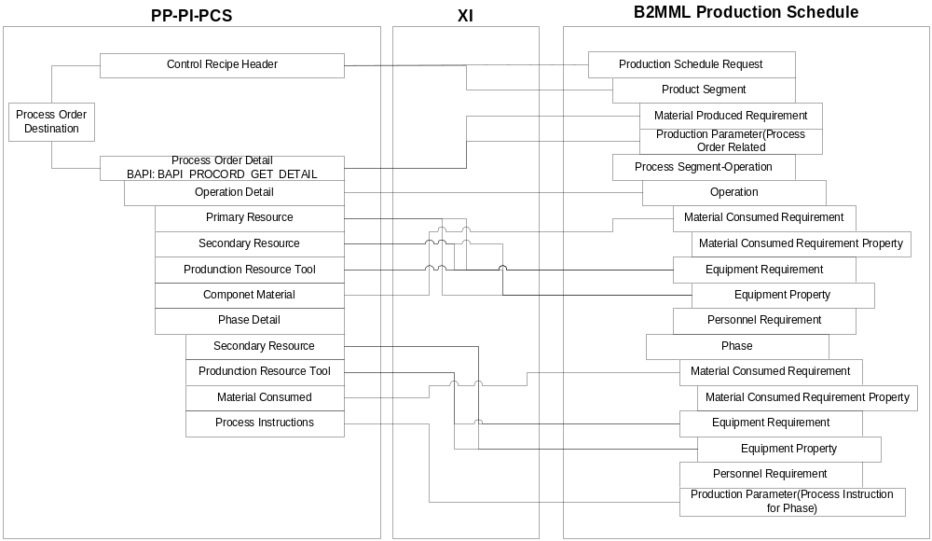
Mapping – Example of Productions Schedule

Slide 32
Mapping Example
SAP-PP,PM,SCM
SAP NetWeaver xMII
S95 Compliance Shopfloor Application
Transform the Incoming request to a B2MML Standard XML Message
Receives the B2MML Standard XML Message
Invoke XI
(E.g. Send Process Order)
Send theB2MML Message to Shop floor application

Slide 33
Agenda
Introduction
MES and Shop Floor Automation Systems (SFA) Overview
Positioning MES SFA with along with ERP
Integrating MES with SAP
Case Study
Open Q & A

Slide 34
About the Company
A Large global Food Manufacturing
Complete SAP Landscape
Multiple MES Systems
Developed B2MML Interface using SAP Business Connector

Slide 35
SAP MES Architecture
SAP R/3
PP-PI
PCS
RFC/BAPI Calls
SAP Business Connector 4.6
Marcator to map and dispatch
IBM MQ Series to handle message exchange
B2MML
Standard B2MML Messages
Horizontal Workflow
Horizontal Workflow
Horizontal Workflow
MES
MES
MES
Plant A
Plant B
Plant C

Slide 36
Interface Design and Deployment
Identify SAP BAPI and S 95 equivalence
  To Download recipe
    SAP BAPI ControlRecipe = S 95 Production Schedule
  To report actual production
    SAP BAPI Process MsgPI = S95 Production Performance
Detail Mapping between SAP PP-PI and S95
  May need to change the BAPI; it is complex
Test and Deploy
Resources Required
  Understanding of s95/B2MML
  XSLT Programming
  SAP Business Connector Configuration

Slide 37
Take Aways
MES co-ordinates functions on the shop floor and provides integration between production processes and enterprise systems
Robust integration between ERP and MES is required for flexibility and visibility, and standards like ISA 95 enable that.
There is an overlap of functionality offered by ERP and MES. It is critical to make the decision up front where the functionality resides.
xMII is the preferred integration option in the SAP landscape

Slide 38
Agenda
Introduction
MES and Shop Floor Automation Systems (SFA) Overview
Positioning MES SFA with along with ERP
Integrating MES with SAP
Case Study
Open Q & A

Slide 39
Contact:
Sham Afzalpurkar
CEO
Performix Inc
Email: sham@performixinc.com
Cell: (281)610-4164
Tel: (713)995-8118

Slide 40

4008
Session Code:

